Slide 1
Book Recommendation Project –P413
GROUP -2​

Slide 2
Members
P
M. Pradeep Sai
Sai Srinivas
Ashwini
Munesh
Daneshwari

Slide 3


Agenda
A
Business Objective
Content/Dataset
Python Libraries
Visualization
Different filtering techniques
Model Building

Slide 4
Business Objective:
Generate the features from the dataset and use them to recommend the books accordingly to the users.

Slide 5
What is Book Recommendation System?
A book recommendation system is a software application or algorithm designed to suggest books to users based on various factors. These factors can include a user’s past reading history, preferences, ratings, reviews, and similarities to other users or books. The goal is to provide personalized book suggestions that the user is likely to enjoy.
Types of Book Recommendation Systems :
Content-Based Filtering: This approach focuses on the attributes of the books themselves, such as genre, author, and keywords. It recommends books that are similar to those a user has liked in the past, based on the content features.
Collaborative Filtering: This method makes recommendations based on the behavior and preferences of similar users. It analyzes patterns from a user’s past interactions and compares them with those of other users to suggest books that those similar users enjoyed.
3. Hybrid Systems: These systems combine both content-based and collaborative filtering methods to provide more accurate and diverse recommendations by leveraging the strengths of both approaches

Slide 6
Importance of Book Recommendation System :
Book recommendation systems play a crucial role in enhancing user satisfaction and engagement for several reasons:
Helps readers discover new books: They can expose readers to books they might not have found on their own, broadening their horizons and introducing them to new favorites.
Saves time and effort: Instead of spending hours browsing or relying on random picks, readers can get personalized suggestions that are more likely to appeal to their taste.
Boosts sales for publishers and retailers: By recommending relevant books, these systems can encourage readers to buy more books, benefiting the entire book industry.
User Retention: By consistently recommending books that users enjoy, these systems can improve user retention rates for book services and apps, encouraging users to return frequently.
Increased Engagement: By keeping users engaged with personalized suggestions, recommendation systems can increase the time users spend on the platform, leading to higher engagement rates.

Slide 7
Content
Dataset

Slide 8
The Book-Crossing dataset comprises 3 files.
Users
Contains the users. Note that user IDs (User-ID) have been anonymized and map to integers.
Demographic data is provided (Location, Age) if available. Otherwise, these fields contain
NULL-values.
Books
Books are identified by their respective ISBN. Invalid ISBNs have already been removed from the
dataset. Moreover, some content-based information is given
(Book-Title, Book-Author, Year-Of-Publication, Publisher), obtained from Amazon Web
Services. Note that in case of several authors, only the first is provided. URLs linking to cover
images are also given, appearing in three different flavours
(Image-URL-S, Image-URL-M, Image-URL-L), i.e., small, medium, large. These URLs point to the
Amazon web site.
Ratings
Contains the book rating information. Ratings (Book-Rating) are either explicit, expressed on a
scale from 1-10 (higher values denoting higher appreciation), or implicit, expressed by 0.

Slide 9
Python Librararies
The python libraries and packages we’ll use in this project are namely:
NumPy
Pandas
Seaborn
Matplotlib
Wordcloud

Slide 10
EDA
Exploratory Data Analysis

Slide 11
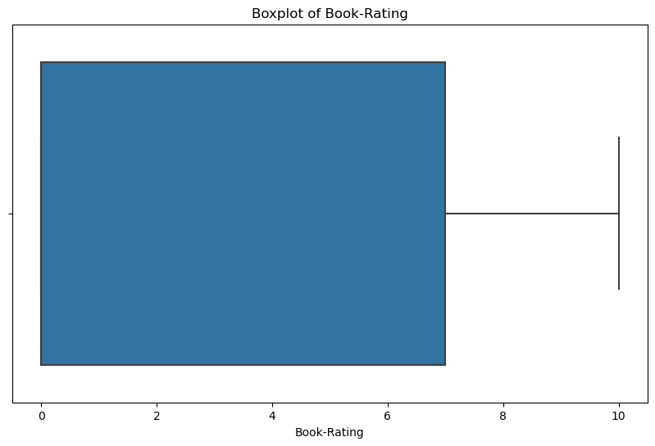
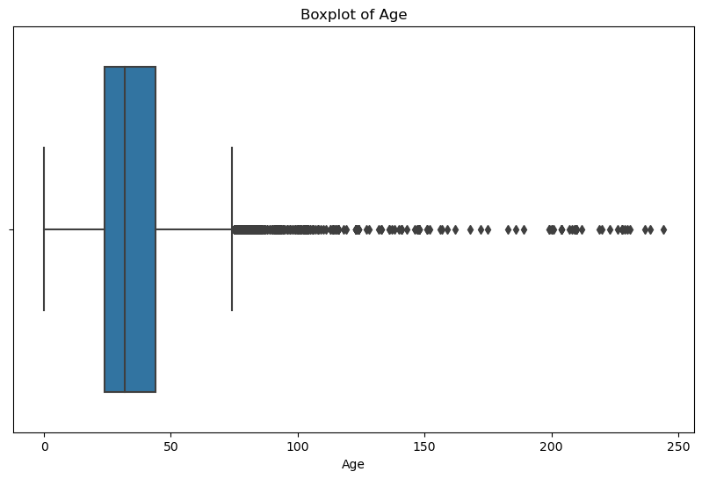
Constructing Boxplot for Rating and Age
(i) Book rating
(ii) Age

Slide 12
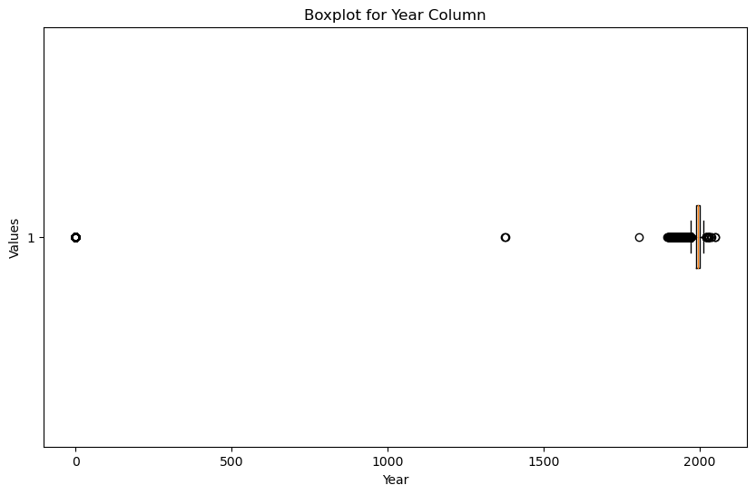
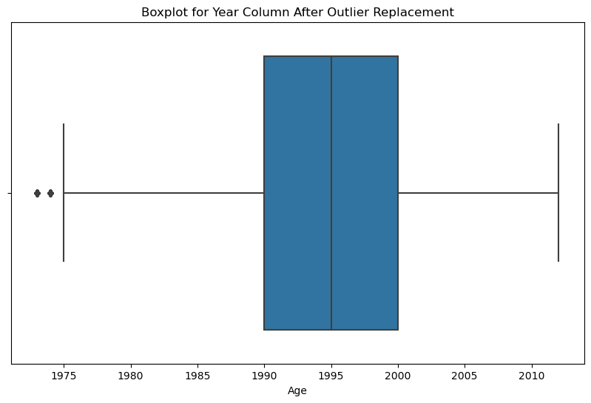
Boxplot for Year
Median
Imputation

Slide 13
Data Visualization

Slide 14
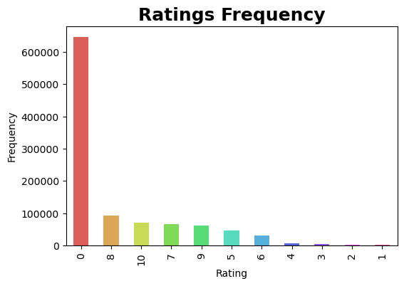
Visualising Explicit Rating Counts

Slide 15
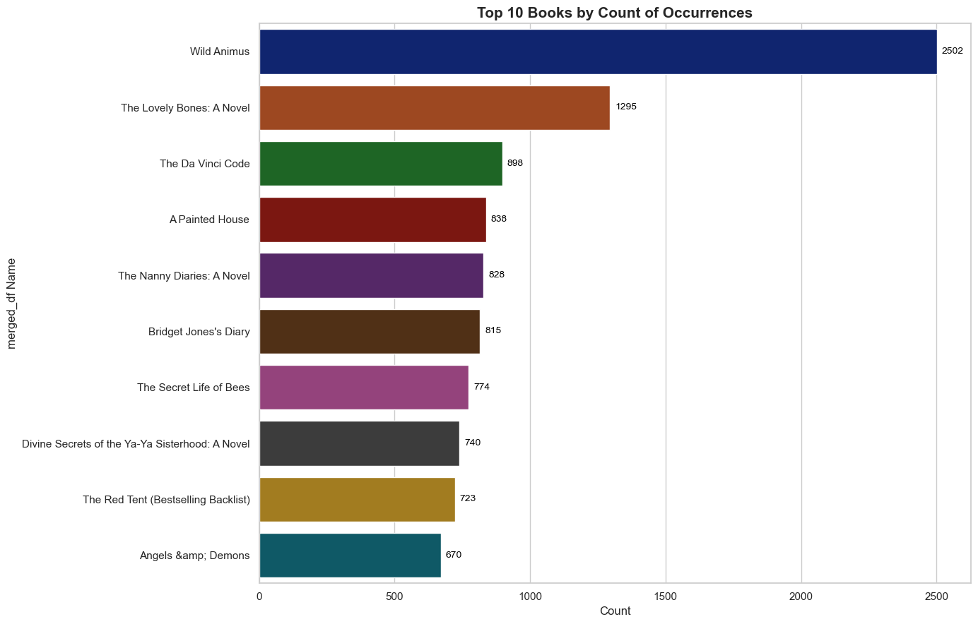
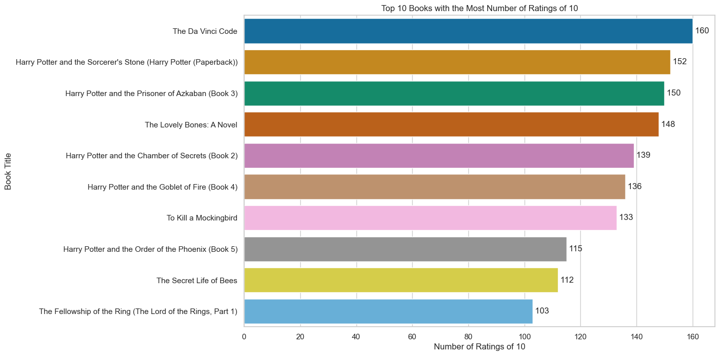
Top 10 books by count and the most no of 10 ratings

Slide 16
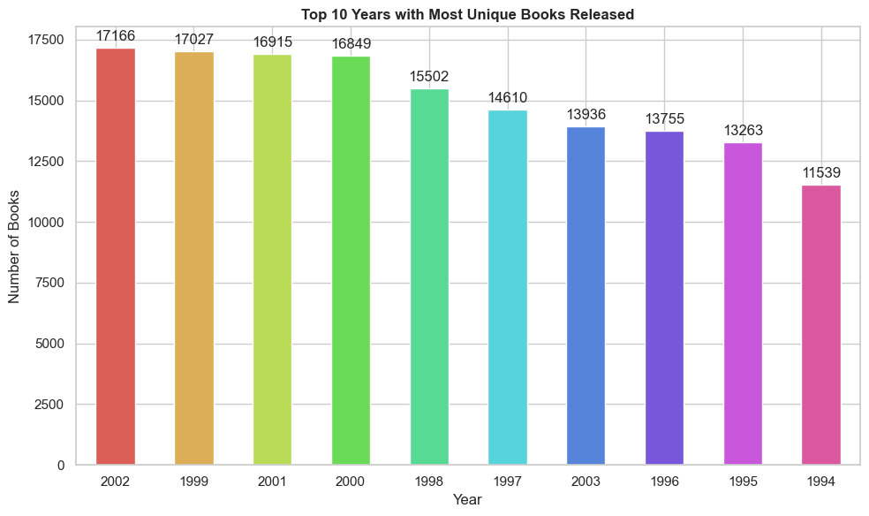
Visualizing top 10 years with most no of unique books released:

Slide 17
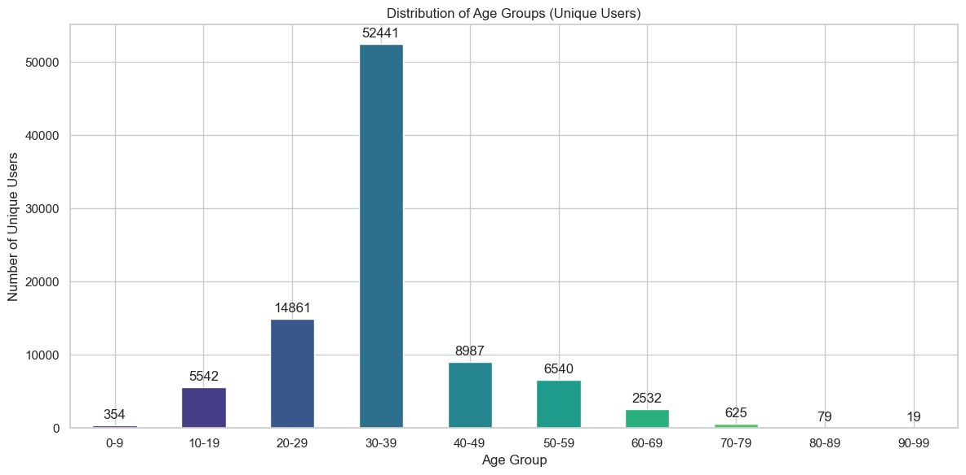
Visualizing the age distribution of the users

Slide 18
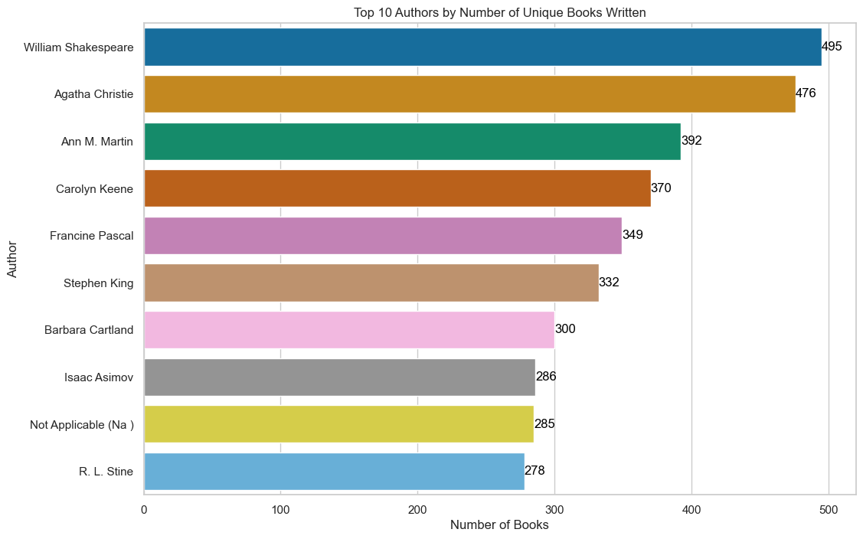
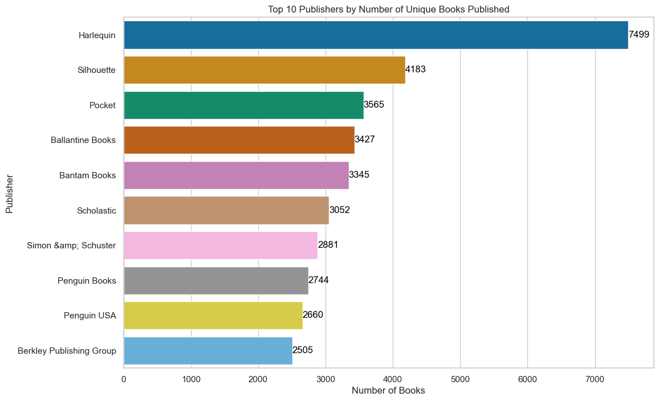
Visualizing top 10 Authors and Publishers

Slide 19
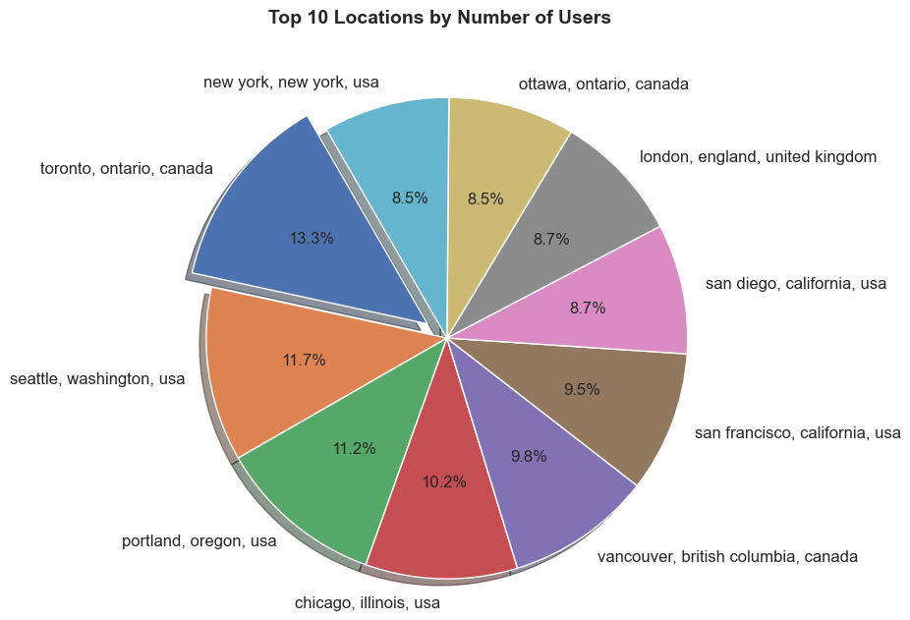
Visualizing top 10 Locations by no of Users

Slide 20
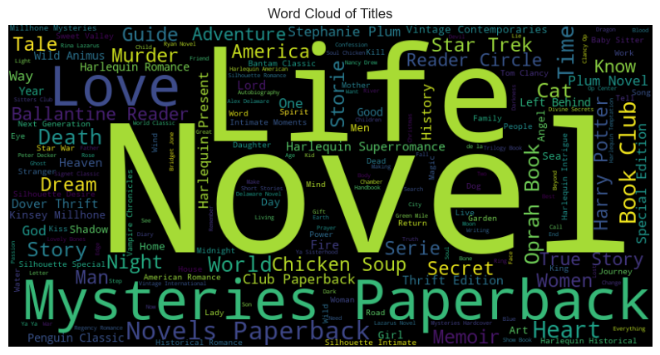
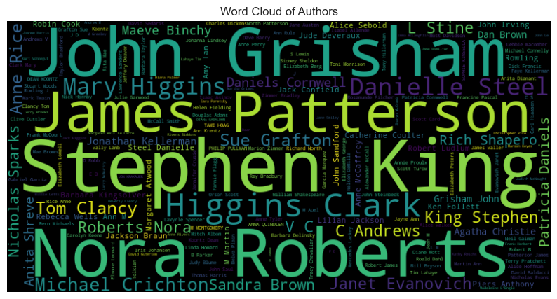
Displaying most frequent words in Title & Author

Slide 21
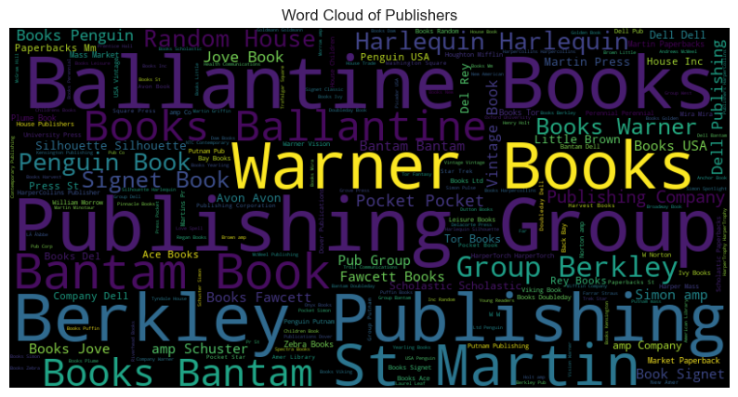
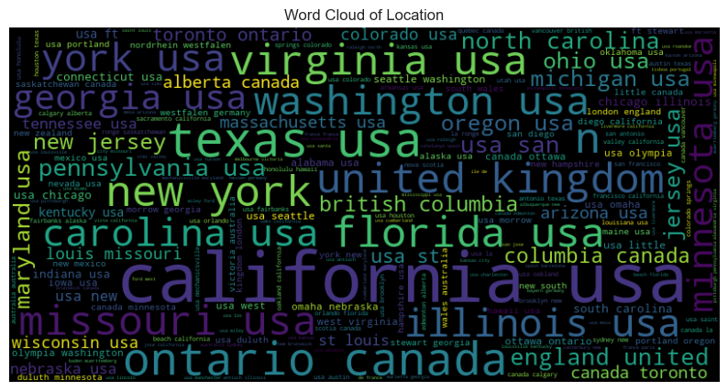
Displaying most frequent words in Publisher & Location

Slide 22
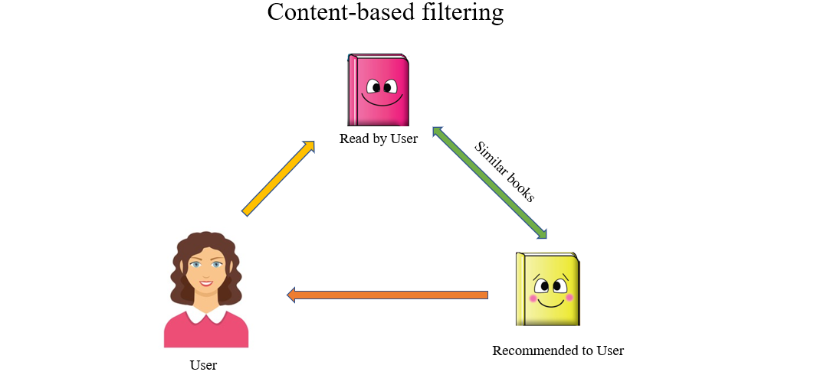
Different Filtering Techniques
Content-Based Filtering:
In recommendation systems, Content-based filtering (CBF) is a technique that recommends items to users based on the features or characteristics of items the user has interacted with in the past. It focuses on building a user profile that captures their preferences by analyzing the attributes of items they've liked, disliked, purchased, viewed, or otherwise engaged with.

Slide 23
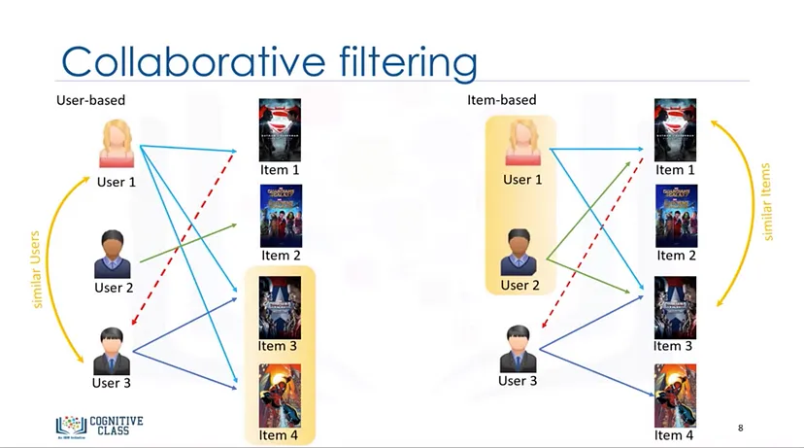
Different Filtering Techniques
Collaborative Filtering:
Collaborative filtering is a technique used in recommender systems to predict a user's interests and preferences. Unlike content-based filtering which focuses on item features, collaborative filtering leverages the power of the crowd.
There are two main approaches to collaborative Filtering:
User-based Collaborative Filtering:
Recommends items to a target user based on the preferences and behaviors of similar users. It focuses on finding users with similar tastes and recommending items that these similar users have liked.
2. Item-based Collaborative Filtering:
Recommends items to a target user based on the similarities between items themselves. It focuses on finding items that are similar to ones the user has already liked or interacted with.

Slide 24
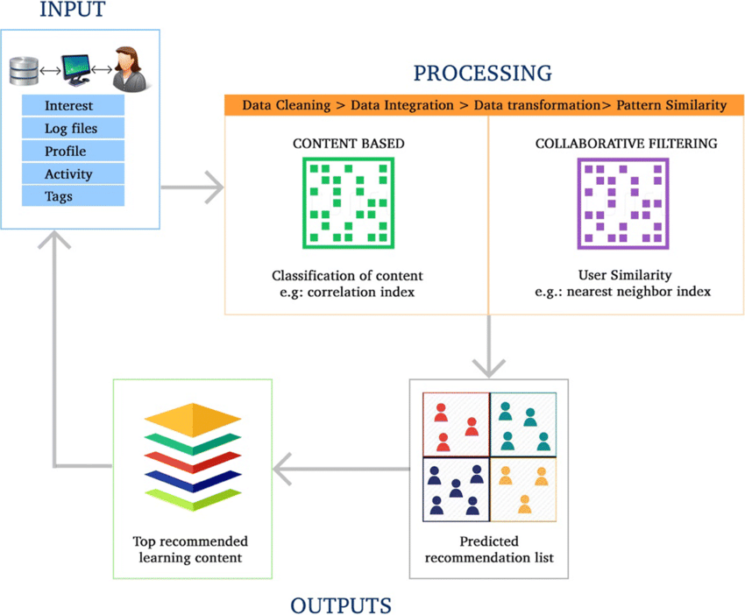
Different Filtering Techniques
Hybrid Filtering:
A hybrid recommendation system combines multiple recommendation techniques to provide more accurate and diverse recommendations to users. It leverages the strengths of different approaches, such as collaborative filtering and content-based filtering, to overcome their limitations and improve the recommendation process.

Slide 25
Model Building
1. Cosine Similarity
2. KNN
3. K-Means

Slide 26
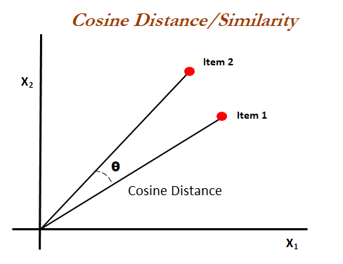
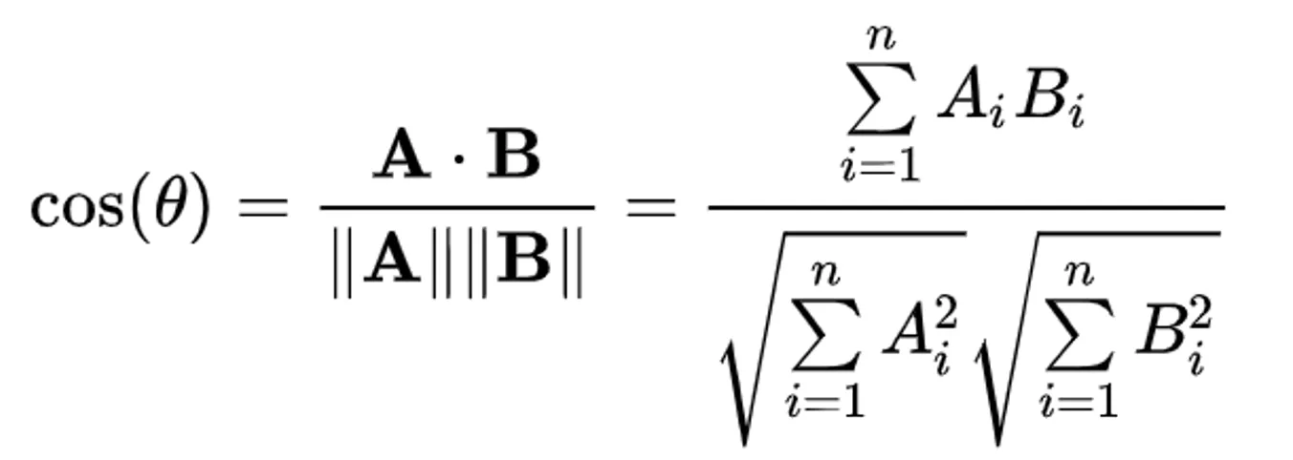
1. Book Recommendation using Cosine Similarity
Cosine-based Similarity :
Cosine similarity is a mathematical technique used in recommendation systems to measure the similarity between items or users. It works by representing items or users as vectors in a high-dimensional space, where each dimension corresponds to a feature or attribute. The cosine similarity between two vectors is then calculated based on the angle between them. Intuitively, vectors pointing in the same direction have a higher cosine similarity, indicating greater similarity between the items or users they represent.
In recommendation systems, cosine similarity is often used in content-based filtering approaches. By comparing the item's features, the system can recommend items similar to those the user has interacted with in the past.
Formula :

Slide 27
Working of Cosine similarity in recommendation systems
In an item-based book recommendation system, cosine similarity is utilized to measure the similarity between different books based on their attributes or features. Here’s how cosine similarity is specifically applied in this context:
Item Representation: Each book is represented as a feature vector where each feature corresponds to a characteristic or attribute of the book (e.g., genre, author, publication year, reader ratings, thematic elements).
Cosine Similarity Calculation: To determine how similar two books are to each other, cosine similarity is computed between their respective feature vectors.
Similarity Matrix: The system computes the cosine similarity between each pair of books in the dataset, forming a similarity matrix where each entry sim(i, j) represents the similarity between book i and book j.
Recommendation Process: When recommending books to a user, the system identifies books similar to those the user has interacted with or rated highly. It retrieves the top-N most similar books based on the cosine similarity scores from the similarity matrix.

Slide 28
Benefits of using Cosine Similarity
Interpretability: Cosine similarity is a relatively easy concept to understand. It measures the angle between two item vectors, where a smaller angle indicates higher similarity. This makes it easier to explain why certain items are recommended to a user.
Efficiency: Cosine similarity is computationally efficient, especially for sparse data matrices that are common in recommendation systems. This makes it suitable for real-time recommendation scenarios.
Focus on User Preferences: Cosine similarity focuses on how users have interacted with items in the past. This can be beneficial for discovering hidden patterns in user behavior and recommending items that align with their preferences, even if those items are not explicitly similar based on their features.
Enhanced User Experience: By leveraging cosine similarity, companies like Amazon and Netflix can provide personalized recommendations that improve user engagement and satisfaction. The ability to suggest items based on nuanced similarities enhances the overall customer experience, leading to increased sales and user retention.

Slide 29
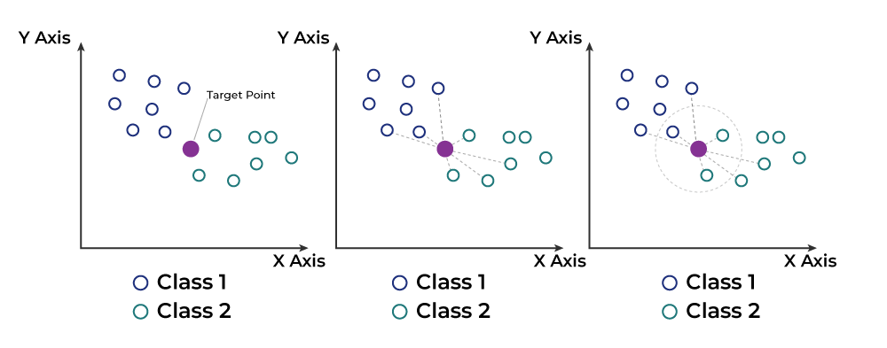
2. Book Recommendation using KNN Algorithm
Book Recommendation Using k-Nearest Neighbors (kNN) is a method of recommending books to users based on the preferences and ratings of similar users. It involves calculating the similarity between users based on their book ratings, identifying the k most similar users (nearest neighbors), and recommending books that these similar users have rated highly but the target user has not yet interacted with. This approach leverages the assumption that users with similar preferences will enjoy similar books, making it a personalized recommendation method.

Slide 30
Working of KNN algorithm
User-Item Matrix: Represent users and their ratings for books in a matrix format. Each row represents a user, each column represents a book, and the entries denote the ratings (if available) that users have given to books.
Similarity Calculation: Calculate the similarity between users based on their ratings using metrics like cosine similarity, Pearson correlation, or others. Cosine similarity is commonly used due to its effectiveness in measuring the direction of preferences regardless of magnitude.
Identifying Nearest Neighbors: For a target user A:
  Compute the similarity between user A and all other users in the dataset.
  Select the top-k most similar users (nearest neighbors) to user A based on the computed similarity scores. These users have similar book preferences to the target user.
Generating Recommendations:
  Identify books that the nearest neighbors have rated highly but the target user A has not yet interacted with.
  Rank these books based on some criteria (e.g., average rating from nearest neighbors, popularity) to create a list of recommended books for user A.

Slide 31
Benefits of using KNN Algorithm
Simplicity and Intuitiveness : KNN is straightforward to implement and understand. It operates by identifying the 'k' most similar items to a target item based on user interaction data. This simplicity makes it an excellent choice for initial prototypes and baseline models in recommendation systems.
Flexibility with Distance Metrics : KNN allows the use of various distance metrics (e.g., Euclidean, Manhattan, cosine similarity) to measure similarity between items. This flexibility enables the algorithm to be tailored to specific datasets and user preferences, enhancing the quality of recommendations.
Non-Parametric Nature : As a non-parametric algorithm, KNN does not make assumptions about the underlying data distribution. This characteristic is particularly beneficial in real-world applications where data may not follow a specific distribution, allowing for more accurate modeling of user preferences.
Scalability : KNN can handle large datasets effectively, especially when optimized with techniques such as approximate nearest neighbors. This scalability is crucial for recommendation systems that need to serve millions of users and items, as it can efficiently compute similarities without requiring extensive retraining of models

Slide 32
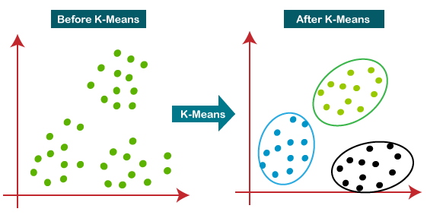
3. Book Recommendation using K-Means
K-Means clustering is an unsupervised machine learning algorithm that groups similar books into clusters based on user ratings. In a book recommendation system, K-Means helps identify clusters of similar books, allowing for recommendations of books within the same cluster as those previously liked by the user.

Slide 33
Working of K-Means
Clustering: Apply K-means to group books into clusters based on their ratings. Books that receive similar ratings from users will be clustered together. This step helps to identify groups of books that are perceived similarly by readers.
2. Recommendation Generation:
- For a user looking for recommendations, identify which cluster their rated books belong to.
- Within that cluster, find other books that are similar (i.e., those that share the same cluster).
- Recommend books from that cluster that the user has not yet rated.

Slide 34
Benefits of using K-Means
Efficient Data Organization : K-Means clustering helps organize items into distinct groups based on their features or user interactions. This categorization simplifies the recommendation process by allowing the system to focus on similar items within each cluster, improving the efficiency of retrieving relevant recommendations.
Improved Recommendation Quality : By grouping similar items together, K-Means can enhance the quality of recommendations. Items within the same cluster are likely to appeal to similar user preferences, which increases the likelihood that users will find the suggested items relevant and appealing.
Scalability : K-Means is computationally efficient and can handle large datasets effectively. This scalability is crucial for recommendation systems that need to process vast amounts of data, allowing for real-time recommendations without significant delays.
Reduced Complexity : K-Means reduces the complexity of the recommendation process. Instead of comparing all items directly, the system can compare items within the same cluster, leading to faster computations and a more straightforward approach to generating recommendations

Slide 35
Thank you
M. Pradeep Sai
Sai Srinivas
Ashwini
Munesh
Daneshwari

